Slide 1






⥫
Unraveling the Magic: The Art of Hashing
Algorithms

Slide 2
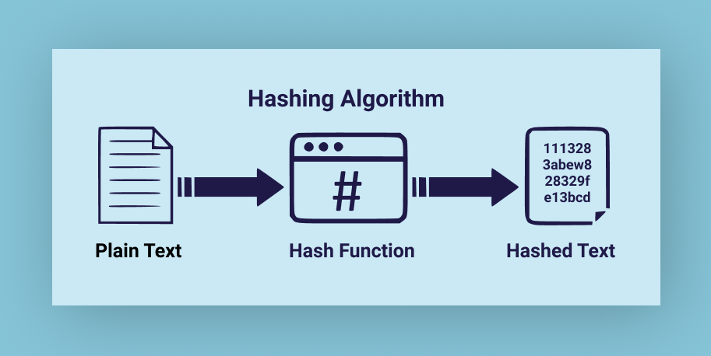




Unveiling the hashing algorithm
Hashing is a technique that converts input data into a fixed-size string of bytes, known as a hash value, using an algorithm. It's used for efficient data organization and retrieval, with each unique input typically producing a unique hash, enabling fast access to stored information.

Slide 3

Example of Hashing
Suppose you have a bunch of students in a class, and you want to organize their names in a list for easy access. Instead of putting them randomly, you use their student ID numbers as keys and apply a magic formula (hashing) to decide where each name goes in the list. So, when you need to find a student's name, you use their ID number with the formula to quickly locate it in the list. This way, finding a student's name becomes much faster because you know exactly where to look based on their ID number.

Slide 4
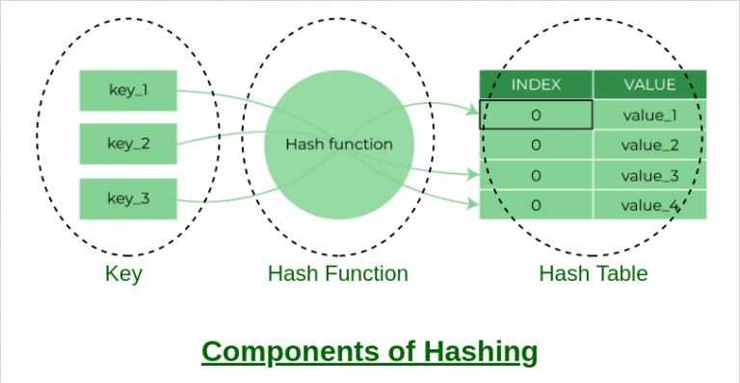





Types of hashing
Method of division
Remainder method
Midsquare method
Truncation method
Shifting method
Folding method
Radix conversion method

Slide 5

Method of division
Division hashing is a simple hashing method that involves dividing the key by a chosen divisor and using the quotient as the hash value
Student ID: 123456
Hash Value: 123456÷10=12345(quotient)
Location of Record: Index 12345 in the hash table
Student ID: 987654
Hash Value: 987654÷10=98765(quotient)
Location of Record: Index 98765 in the hash table

Slide 6
Remainder method
The remainder method, also known as the modulo hashing method, is a simple technique where the hash value is obtained by taking the remainder of the key divided by a chosen divisor. Input: Employee IDs
Compute the Hash Value:
For Employee ID 12345: 12345mod 7=4
For Employee ID 98765: 98765mod 7=3
For Employee ID 54321: 54321mod 7=3
Use the Hash Value:
Employee ID 12345 will be stored at index 4 in the hash table.
Employee ID 98765 and 54321 both hash to index 3, so they might need to be handled using collision resolution techniques like chaining or probing.

Slide 7
Mid-square method
The Mid-Square method is a hashing technique that involves squaring the key and then selecting a portion of the resulting digits as the hash value.
Input: Student IDs
Square the Key: For example, if we have a student ID of 1234, we square it to get 12342=1522756.
Select Digits: Choose a portion of the digits from the squared result. For example, if we choose the middle two digits, we get 2222 from 1522756
Use the Hash Value: The selected digits, 2222, are used as the hash value to determine the location of the record in the hash table.

Slide 8
Truncation Method
The truncation method is a simple hashing technique where a portion of the key's digits are selected to form the hash value
Input: Employee IDs
Select Digits: For example, if we choose the last three digits from each employee ID:
For Employee ID 123456789, we select the last three digits, which are 789.
For Employee ID 987654321, we select the last three digits, which are 321.
For Employee ID 543216789, we select the last three digits, which are 789.
Use the Hash Value: The selected digits, 789, 321, and 789, are used as the hash values to determine the location of the records in the hash table.

Slide 9

collision
A collision in the context of hashing occurs when two different inputs produce the same hash value. In other words, it's when two distinct pieces of data map to the same location or index in a hash table. Collisions can happen due to the finite range of hash values compared to the potentially infinite set of input data.
For example
Key "a" hashes to index 1 (because 5 % 3 = 2).
Key "b" also hashes to index 1 (because 6 % 3 = 2).
Here, "apple" and "banana" both hash to the same index (index 1), causing a collision.

Slide 10
Collision resolution techniques
Open Addressing:
In open addressing, when a collision occurs, the algorithm searches for another empty slot in the hash table to place the colliding key.
There are several variations of open addressing, including linear probing, quadratic probing, and double hashing.
Linear probing involves searching for the next available slot by incrementing the hash value by a fixed interval until an empty slot is found.
Quadratic probing uses a quadratic function to determine the next slot to probe, providing better clustering resistance than linear probing.
Double hashing involves using a secondary hash function to calculate the step size for probing, reducing the likelihood of clustering.
Open addressing is typically used when memory is a concern or when the size of the hash table is fixed.
Chaining:
In chaining, each slot in the hash table is associated with a linked list or another data structure.
When a collision occurs, the colliding keys are added to the linked list at the corresponding slot.
Chaining allows multiple keys to map to the same hash value, effectively handling collisions without requiring additional probing or searching.
Chaining is flexible and can handle a large number of collisions efficiently, making it suitable for dynamic hash tables where the size may vary over time.

Slide 11
Thankyou

